Slide 1
APPLETS
An applet is a special kind of java program that is run when embedded in another application(usually a java-enabled web browser, or a specialized tool such as the appletviewer).
The java.applet.Applet class provides a standard framework for developing applets.
In order to run an applet, an HTML (Hyper Text Markup Language) file with appropriate information about the applet’s class file must be provided.

Slide 2
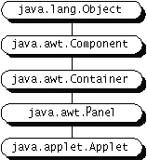
Inheritance Hierarchy of the Applet class

Slide 3
Local and Remote Applets
Applets can be embedded into web pages in two ways :
  We can write our own applets and embed them into web pages.
  We can download an applet from a remote computer system and then embed into a web page.

Slide 4
Local Applet
An applet developed locally and stored in a local system is known as a local applet.
When a web page is trying to find a local applet,it does not need to use the internet connection.
It simply searches the directories in the local system and locates and loads the specified applet.

Slide 5
Remote Applet
A remote applet is that which is developed by someone else and stored on a remote computer connected to the internet.
If our system is connected to the internet, we can download the remote applet onto our system via the internet and run it.
In order to locate and load a remote applet, we use the applet’s URL address.

Slide 6
Differences between Applets and Applications
Applets do not use the main( ) method for initiating the execution of the code.
Applets when loaded, automatically call certain methods of Applet class to start and execute the applet code.

Slide 7
Security Restrictions on applets
Applets cannot read from or write to the files in a local computer.
Applets cannot communicate with other servers on the network.
Applets cannot run any program from the local computer.
Applets are restricted from using libraries from other languages such as C or C++.

Slide 8
APPLET LIFE CYCLE
Every applet is implemented by creating a subclass of the Applet class.As a result, when an applet is loaded, it undergoes a series of changes in its state.
The applet states include :
  Born or Initialization state
  Running state
  Idle state
  Dead or Destroyed state

Slide 9
Applet Life Cycle
Born
init( )
Begin (Load Applet)
Initialization
stop( )
Running
Idle
Stopped
Display
start( )
destroy( )
paint( )
Dead
End
Destroyed
Exit of Browser

Slide 10
Initialization state
Applet enters the initialization state when it is first loaded.
This is achieved by calling init( ) method of Applet class.The applet is born.
At this stage,we may do the following :
  Create objects needed by the applet
  Set up initial values
  Load images or fonts
  Set up colors

Slide 11
Contd..
The initialization occurs only once in the applet’s life cycle.
To provide any of the behaviours mentioned above, we must override the init( ) method :
    public void init( )
    {
    ………..
    ……….. (Action)
    ………..
    }

Slide 12
Running state
Applet enters the running state when the system calls the start( ) method of Applet class.
This occurs automatically after the applet is initialized.
Starting can also occur if the applet is already in “stopped”(idle) state.
For e.g., we may leave the web page containing the applet temporarily to another page and return back to the page.This again starts the applet running.

Slide 13
Contd..
Note that, unlike init( ) method, the start( ) method may be called more than once.
We may override the start( ) method to create a thread to control the applet.
    public void start( )
    {
    ……….
    ……….(Action)
    ……….
    }

Slide 14
Idle or Stopped state
An applet becomes idle when it is stopped from running.
Stopping occurs automatically when we leave the page containing the currently running applet.
We can also do so by calling the stop( ) method explicitly.

Slide 15
public void stop( )
    {
    ……….
    ……….(Action)
    ……….
    }

Slide 16
Dead state
An applet is said to be dead when it is removed from memory.
This occurs automatically by invoking the destroy( ) method when we quit the browser.
Like initialization, destroying state occurs only once in the applet’s life cycle.

Slide 17
Contd..
destroy( ) method can be used to clean up the resources.
    public void destroy( )
    {
    ……….
    ……….(Action)
    ……….
    }

Slide 18
Display state
Applet moves to the display state when it has to perform some output operations on the screen.
This happens immediately after the applet enters into the running state.
The paint( ) method of the Applet class is called to accomplish this task.

Slide 19
Contd..
We must therefore override this method if we want anything to be displayed on the screen.
    public void paint( Graphics g)
    {
    ……….
    ……….(Display statements)
    ……….
    }

Slide 20
Contd..
This requires that the applet code imports the java.awt package that contains the Graphics class.
All output operations of an applet are performed using the methods defined in the Graphics class.
It is to be noted, that display state is not considered as a part of the applet’s life cycle.

Slide 21
//A simple applet example
import java.awt.*;
import java.applet.*;
/* <applet code="SimpleApplet" width=200 height=160> </applet> */
public class SimpleApplet extends Applet {
public void paint(Graphics g) {
g.drawString("A Simple Applet", 20, 20);
}
}

Slide 22
First compile the applet as
  C:\JAVA> javac SimpleApplet.java
Use the following command to run the applet :
  C:\JAVA>appletviewer SimpleApplet.java

Slide 23
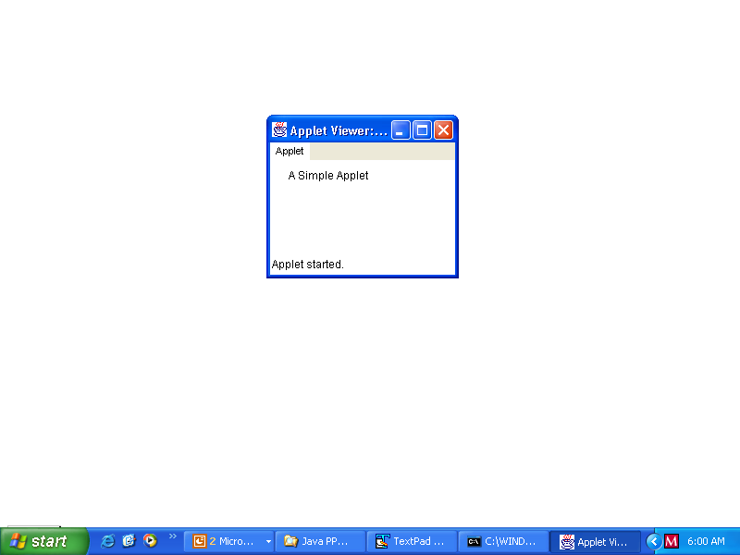

Slide 24
Using web browser to run the applet
/* Save the following HTML code in the file SimpleApplet.html, and put it in the same directory where the SimpleApplet.class file is saved. Open the .html file from your browser to view applet.
Run the applet with appletviewer as
C:\JAVA>appletviewer SimpleApplet.html */
<html>
<head><title>SimpleApplet</title></head>
<body>
<applet code="SimpleApplet.class" width=200 height=200> Sorry! Your Browser doesn't support Java </applet>
</body>
</html>

Slide 25
Simple.java

Slide 26
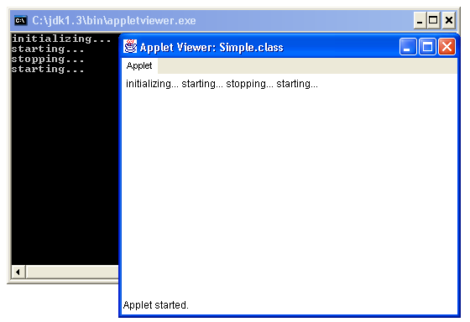

Slide 27
The syntax of the <APPLET> tag in full is shown below :
<APPLET [ CODEBASE = codebase_URL]
CODE = AppletFileName.class
[ ALT = alternate_text ]
WIDTH = pixels
HEIGHT = pixels
[ ALIGN = alignment]
[ VSPACE = pixels ]
[ HSPACE = pixels ]
>

Slide 28
Contd..
[ < PARAM NAME = name1 VALUE = value1> ]
[ < PARAM NAME = name2 VALUE = value2> ]
…………………………………………
…………………………………………
[ Text to be displayed in absence of Java]
</APPLET>
NOTE : yellow tags are mandatory.

Slide 29
ATTRIBUTES OF APPLET TAG
Attribute | Meaning
CODE = AppletFileName.class | Specifies the name of the applet .class file. The file name is interpreted relative to the directory of its applet HTML file (called the document base)
CODEBASE = codebase_URL (optional) | Specifies the URL of the directory (called the code base) in which the .class files and the other resources for the applet are located. The code attribute is then interpreted relative to this directory. If the applet resides in the same directory as the HTML file, then the CODEBASE attribute may be omitted entirely.

Slide 30
Attribute | Meaning
WIDTH = pixels HEIGHT = pixels | These attributes specify the width and height of the space on the HTML page that will be reserved for the applet.
ALIGN = alignment (optional) | This optional attribute specifies where on the page the applet will appear. Possible values for alignment are :TOP, BOTTOM, LEFT, RIGHT, MIDDLE.

Slide 31
Attribute | Meaning
HSPACE = pixels (optional) | This attribute specifies the amount of horizontal blank space the browser should leave surrounding the applet.
VSPACE = pixels (optional) | VSPACE specifies the amount of vertical blank space the browser should leave surrounding the applet.

Slide 32
Attribute | Meaning
ALT = alternate_text (optional) | This optional attribute specifies any text that should be displayed if the browser understands the APPLET tag but can't run Java applets.
Alternate Text | A java-illiterate browser will always display this optional alternative HTML text specified inside the <applet> tag. This text will be ignored by a java-enabled browser.

Slide 33
PASSING PARAMETERS TO APPLET
User defined parameters can be supplied to an applet by using <PARAM…> tag.
Each <PARAM…> tag has a name attribute such as color and a value attribute such as red.
Inside the applet code, the applet can refer to that parameter by name to find its value.
To retrieve a parameter, use getParameter( ) method.It returns the specified parameter in the form of a String object.
Thus, for numeric and boolean values, you will need to convert their string representations into their internal formats.

Slide 34
ParamDemo.java

Slide 35
//Save the following code in ParamDemo.html in the same directory //as of .class file
<html>
<applet code="ParamDemo" width=300 height=300>
<param name=fontName value=Arial>
<param name=fontSize value=14>
</applet>
</html>

Slide 36
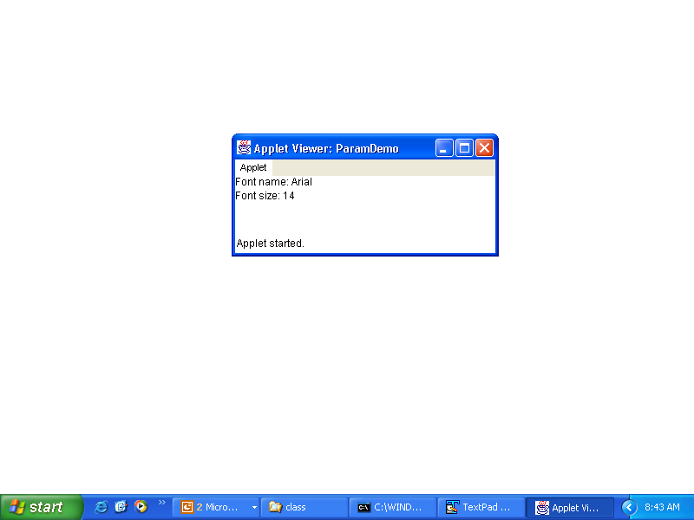

Slide 37
// Display codebase and documentbase.
import java.awt.*;
import java.applet.*;
import java.net.*;
public class Bases extends Applet{
// Display code and document bases.
public void paint(Graphics g) {
String msg;
URL url = getCodeBase() ; /* returns the directory from which the applet’s class file is loaded.*/
msg = "Code base: " + url.toString();
g.drawString(msg, 10, 20);

Slide 38
Contd..
url = getDocumentBase(); /* returns the directory holding the HTML file that starts the applet */
msg = "Document base: " + url.toString();
g.drawString(msg, 10, 40);
}
}

Slide 39
Save the file Bases.class in C:\Applet\class
//Write the following code in Bases.html and save it in C:\Applet\html
<html>
<applet code = Bases codebase="../class" width=150 height=150> Sorry, your browser is not java-enabled</applet>
</html>

Slide 40
Output:
Code base: file:/C:/Applet/class/
Document base: file:/C:/Applet/html/Bases.html

Slide 41
//Drawing Images
import java.applet.Applet;
import java.awt.Graphics;
import java.awt.*;
import java.net.*;
public class SimpleImageApplet extends Applet
{
Image img; URL url; int w,h;
public void init()
{
setBackground(Color.blue);
setForeground(Color.white);
url= getCodeBase();
img= getImage(url,"bear.jpg");

Slide 42
w= getWidth();
h= getHeight();
}
public void paint(Graphics g)
{
showStatus("Width="+w+" Height="+h);
g.drawString("Image in Applet",10,15);
g.drawImage(img,30,70,w,h,this);
}
}

Slide 43
Save the file SimpleImageApplet.java file in C:\Applet\Java
And save the file SimpleImageApplet.class file in C:\Applet\class
Save the image bear.jpg in C:\Applet\class

Slide 44
//Write the following code in SimpleImageApplet.html and save it in C:\Applet\html
<html>
<applet code = SimpleImageApplet codebase="../class" width=150 height=150> Sorry, your browser is not java enabled</applet>
</html>

Slide 45
